Slide 1
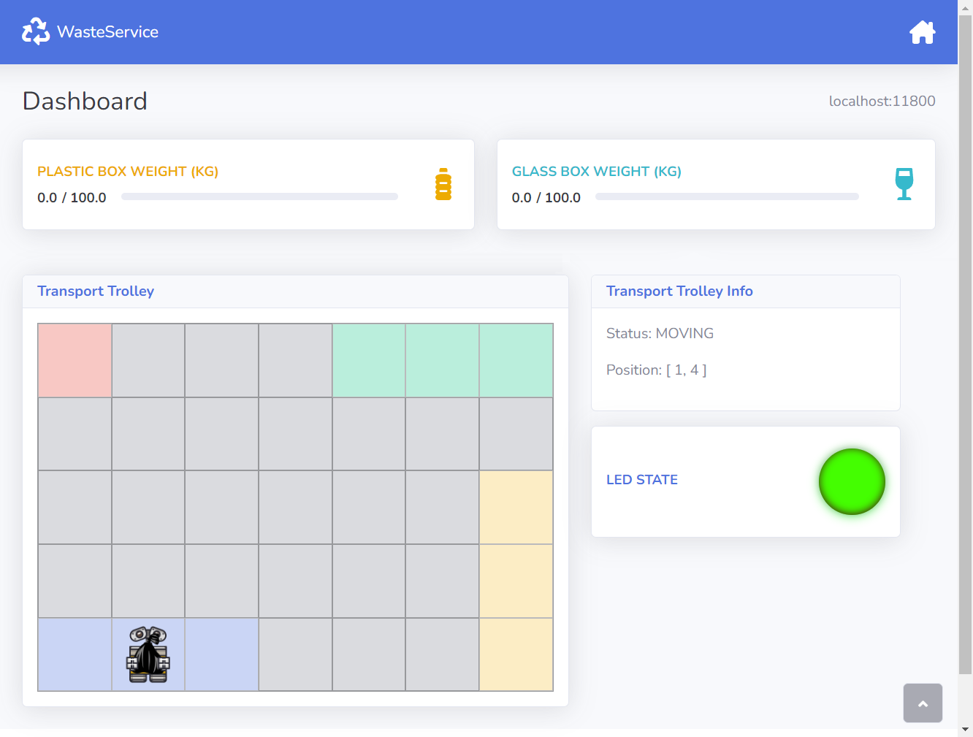
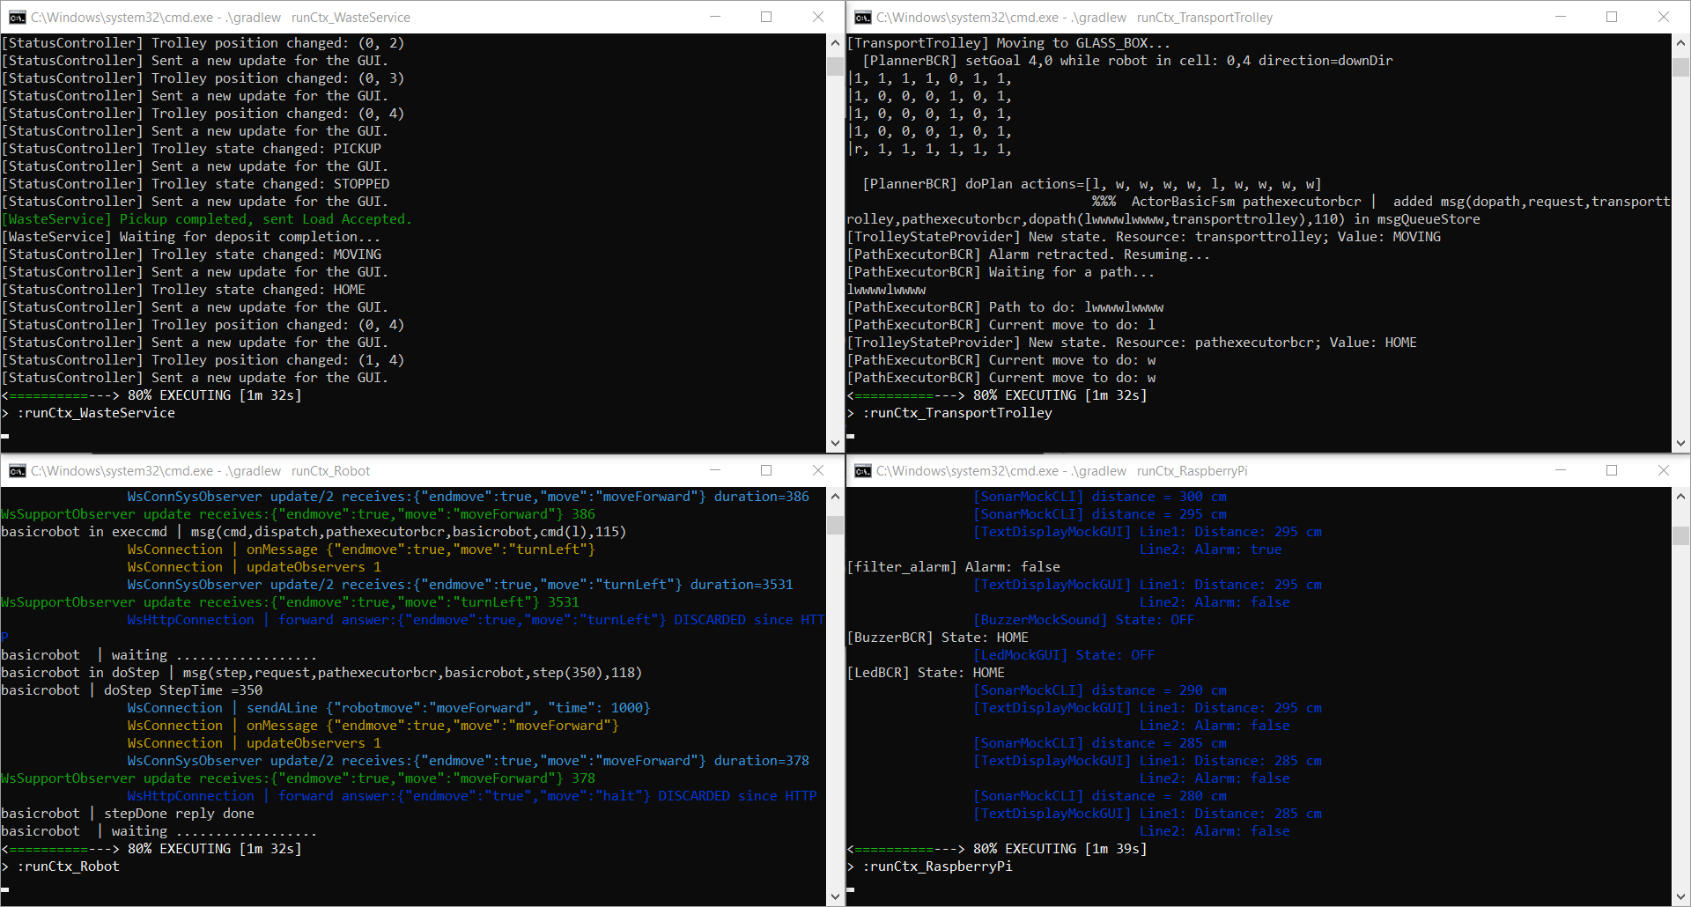
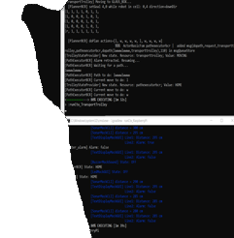
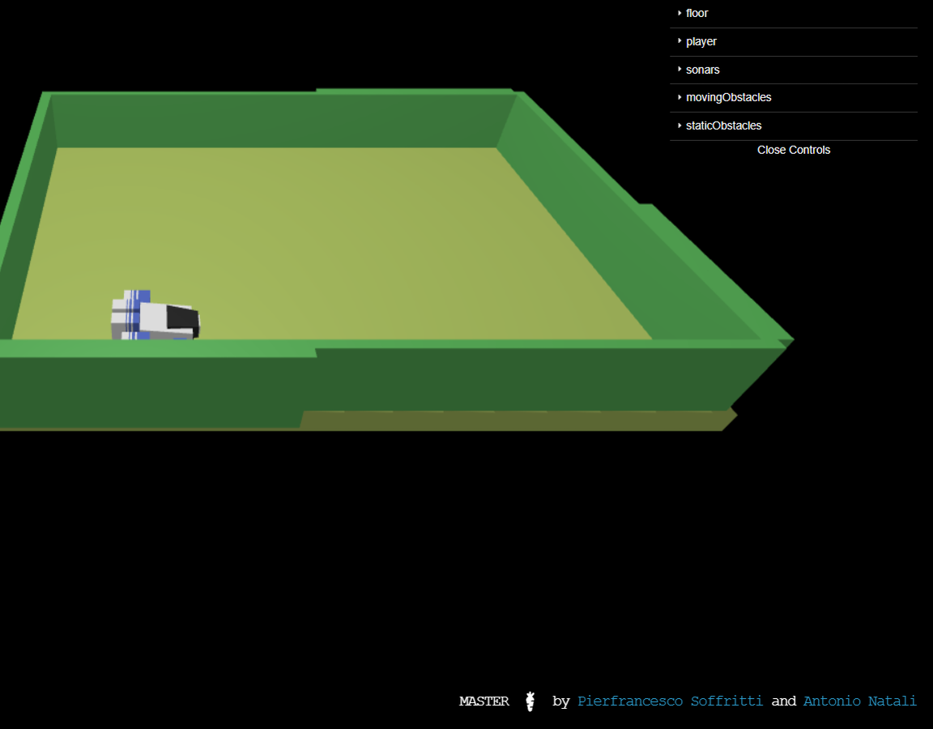
WasteService
Raffaele Battipaglia
Karina Chichifoi
Michele Righi

Slide 2
Project Theme
A company intends to build a WasteService for the separate collection of waste, composed of a set of elements:
A service area (rectangular, flat) that includes:
An Indoor port, to enter waste material.
A PlasticBox container, devoted to store objects made of plastic, up to MAXPB kg of material.
A GlassBox container, devoted to store objects made of glass, up to MAXGB kg of material.
A DDR robot working as a transport trolley, that is initially situated in its Home location. The transport trolley has the form of a square of side length RD.
The transport trolley is used to perform a deposit action that consists of the following phases:
Pick up a waste-load from a waste truck located at Indoor.
Go from the Indoor to the proper waste container.
Deposit the waste-load into the container.
A Service-manager (a human being) which supervises the state of the service-area by using a WasteServiceStatusGUI, that must display:
The current state of the transport trolley and its position in the room.
The current weight of the material stored in the two waste containers.
The current state of the Led.
A Sonar and a Led connected to a RaspberryPi. The Led is used as a warning device, according to the following scheme:
The Led is Off when the transport trolley is at Home.
The Led Blinks while the transport trolley is moving.
The Led is On when the transport trolley is stopped.
NB: The sonar is used as an alarm device: when it measures a distance less than a prefixed value DLIMT, the transport trolley must be stopped. It will be resumed when the sonar detects a distance higher than DLIMT.

Slide 3

Agile Scrum Methodology
Agile scrum methodology is a sprint-based project management system with the goal of delivering the highest value to stakeholders/customers. Each sprint consists of a Scrum goal, a work plan, a sprint review and a sprint retrospective.

Slide 4
Table of Contents
0
1
2
3
Sprint 0
Requirements formalization,
System overview and Model
Sprint 1
WasteService Core-Business
(requirements 1° & 2°)
Sprint 2
WasteService Raspberry Pi
(requirement 4°)
Sprint 3
WasteService Status GUI
(requirement 3°)

Slide 5
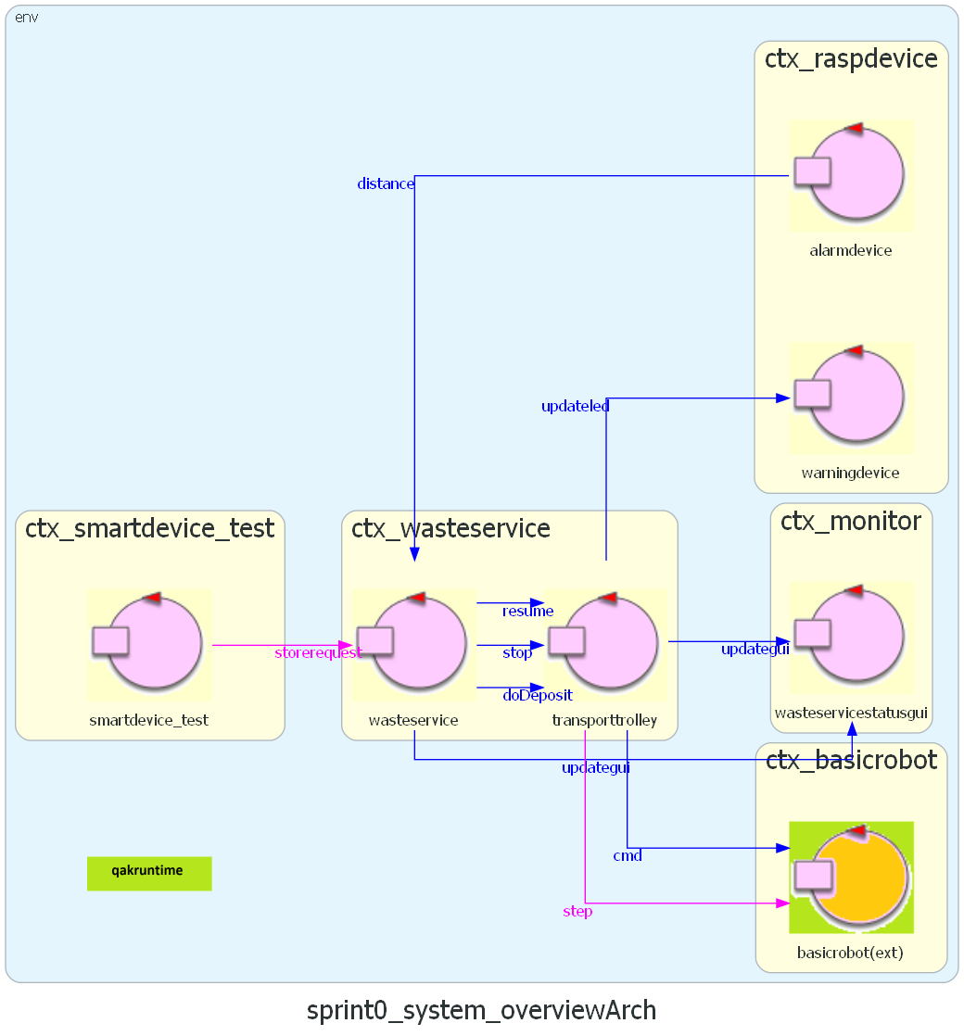
Sprint 0: System Overview
Sprint 1: Core-Business
Requirements 1 & 2
Sprint 2: Raspberry Pi
Requirement 4
Sprint 3: Monitoring
Requirement 3

Slide 6
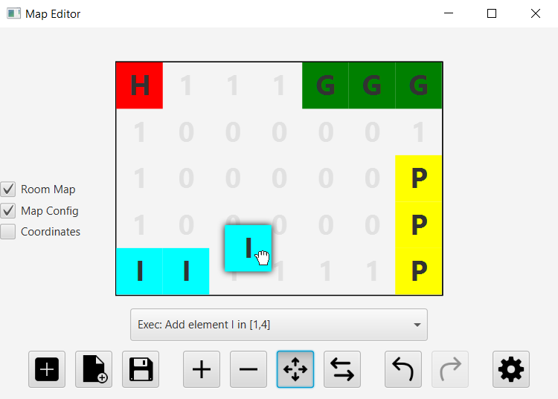
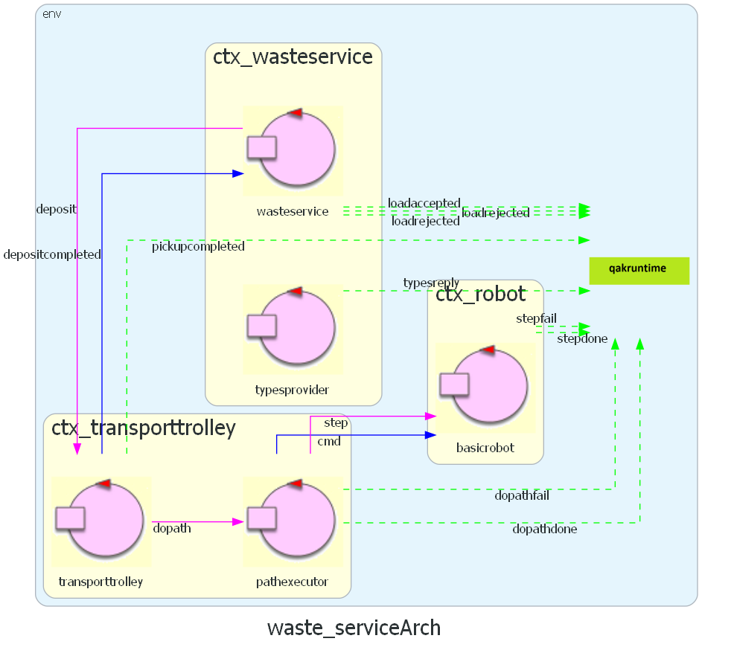
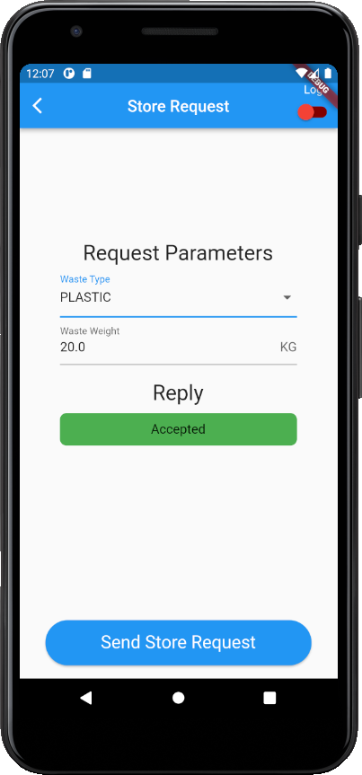
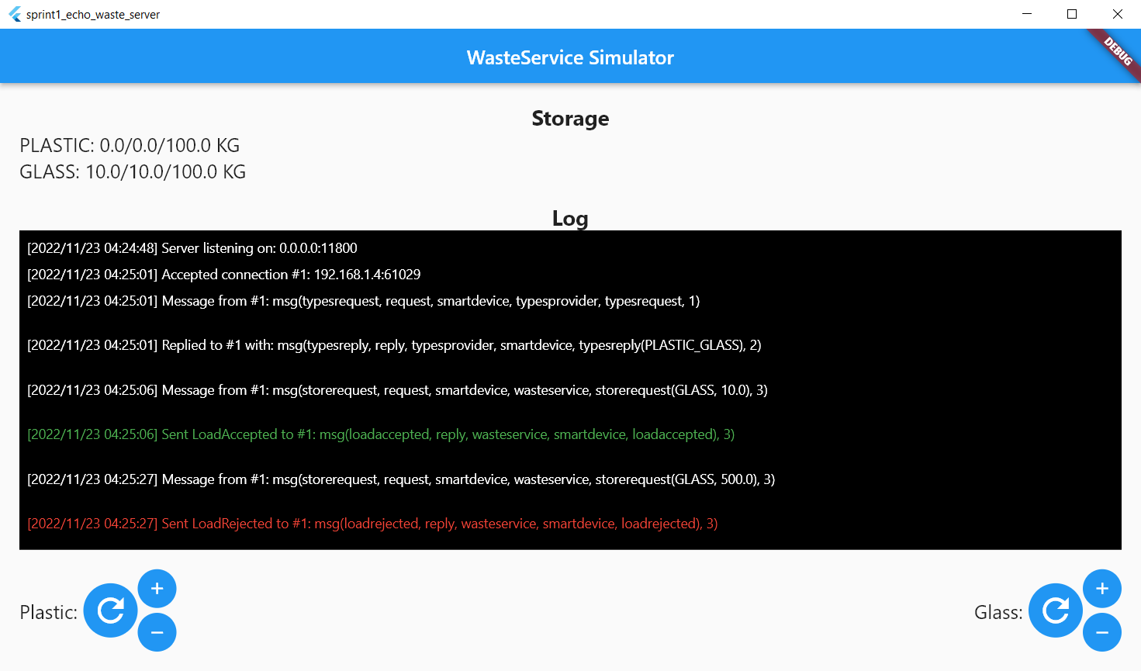
Sprint 1: WasteService Core

Slide 7
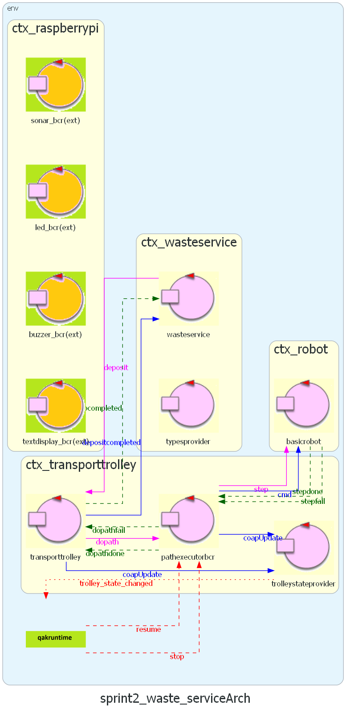
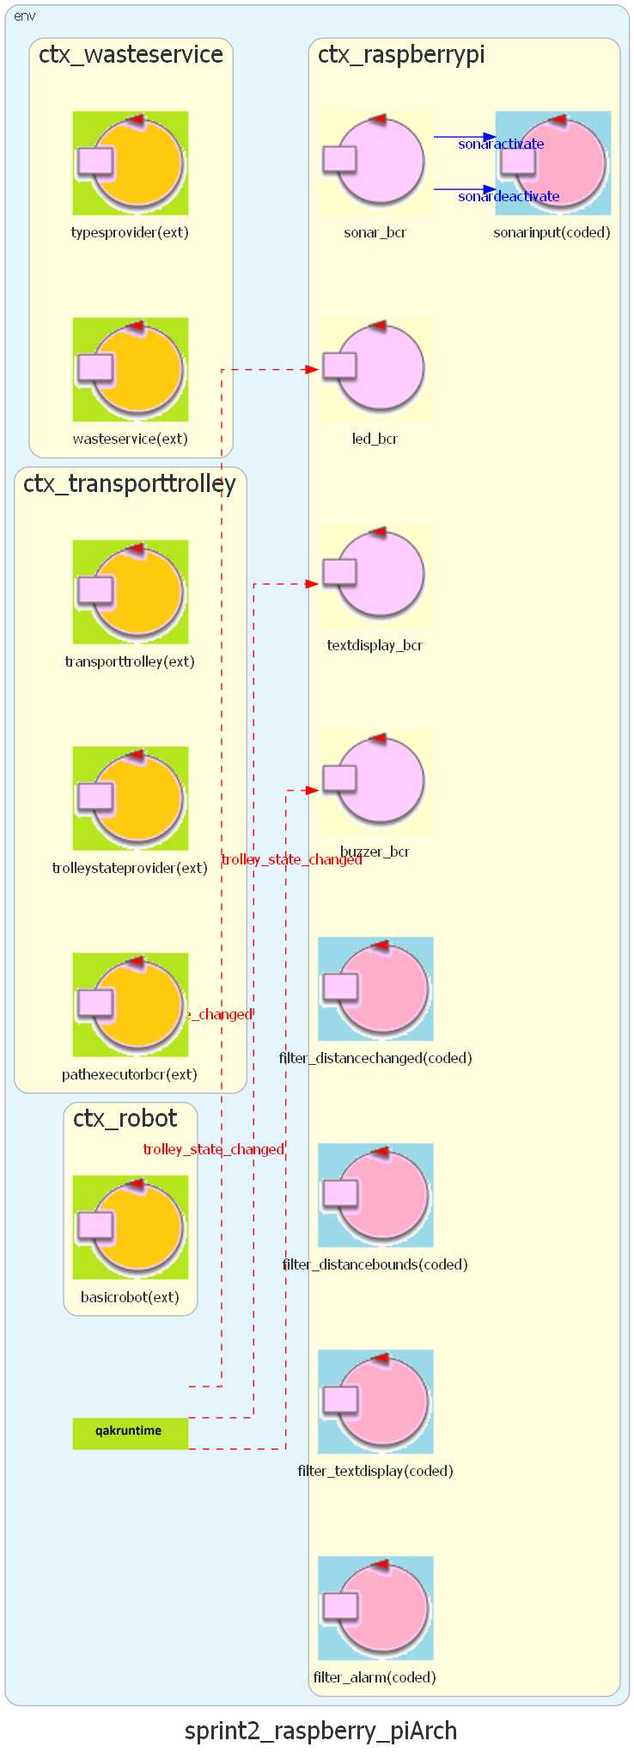
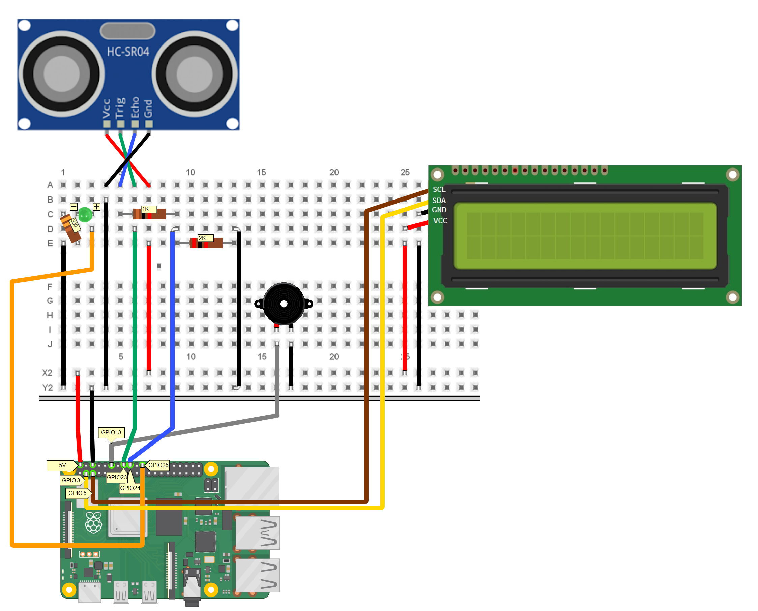
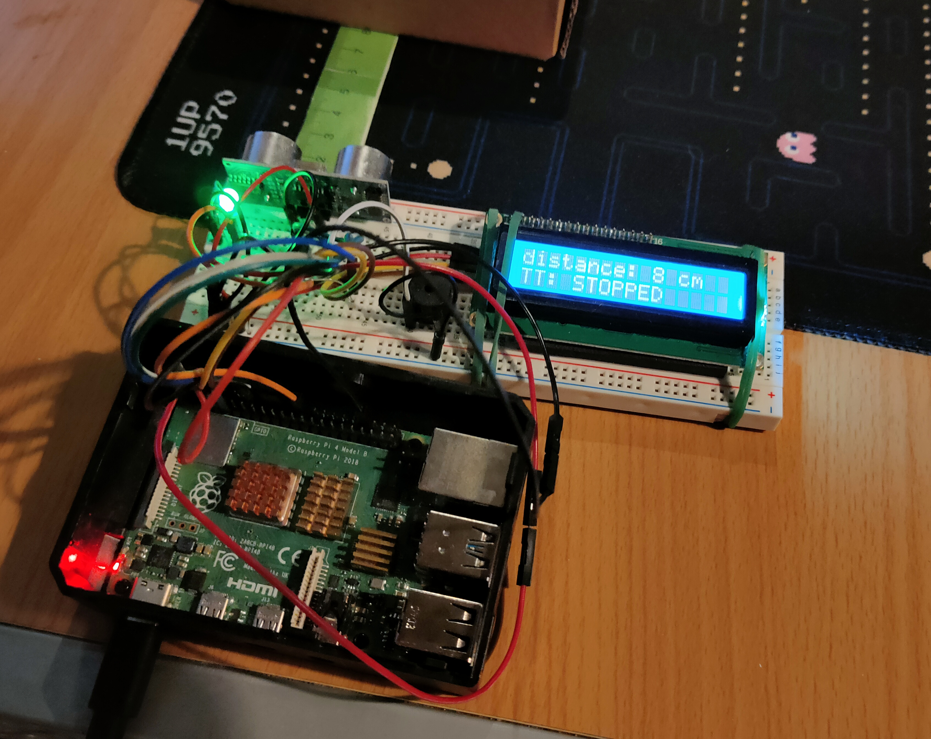
Sprint 2: WasteService RPi

Slide 8
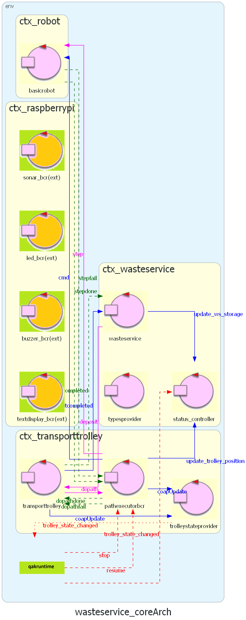
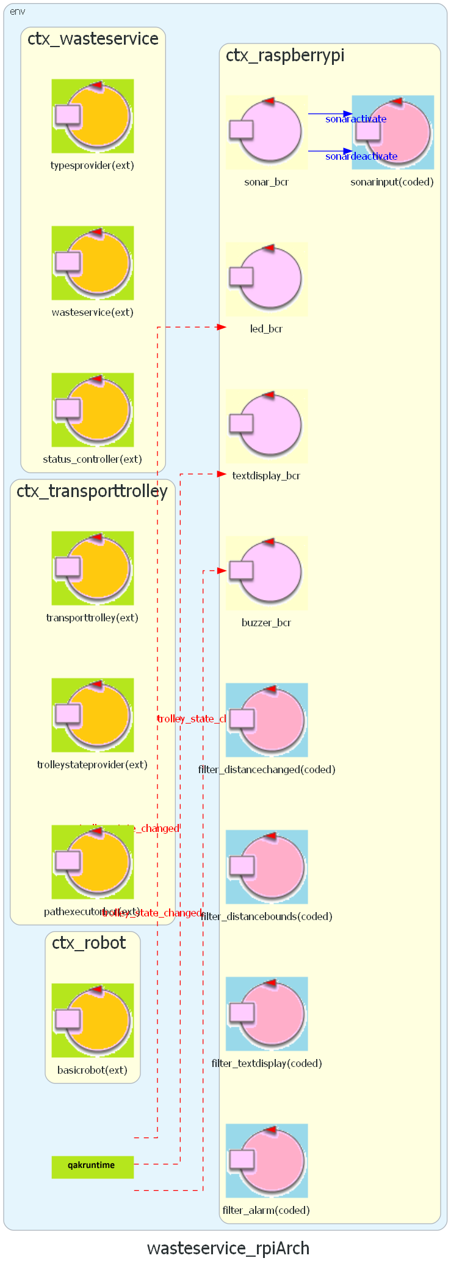
Sprint 3: WasteService GUI

Slide 9
Thanks!
Do you have any questions?
GitHub repository:
iss2022-BCR/WasteService
Please keep this slide for attribution

